Slide 1
MUSIC STREAMING WEBSITE
NAME: JARINA DEVASIA
ROLL NO: 22PMC129
1ST MASTER OF COMPUTER APPLICATIONS

Slide 2
ABSTRACT
It is a system that allows users to explore and listen to a wide variety of songs available on the music streaming website. The project consists of different genres and categories of music, and they are displayed in an organized manner. The user can browse through these songs and add their favorite songs to their personal collection. If the user finds a song they like, they can listen to it instantly. Once the user subscribes successfully, they gain access to a wide range of songs and exclusive content. Thus, the online music streaming project brings a comprehensive music library to users' fingertips, making it convenient and enjoyable for music lovers to discover, listen, and enjoy their favorite tunes.

Slide 3
PROJECT REQUIREMENTS
User Registration and Authentication: Users should be able to create an account and log in securely to access the features of the website.
Song Database: A database to store and manage a large collection of songs, including metadata such as song title, artist, album, genre, duration, and other relevant information.
Song Upload: An interface for authorized users (e.g., artists, administrators) to upload songs to the platform. This may involve file storage and management.
Song Streaming: The ability for users to stream songs on-demand, allowing them to listen to music directly on the website or through a dedicated player.
Playlists and Favorites: Users should be able to create and manage their playlists, as well as mark songs as favorites for quick access.
Search and Browse: A search functionality that allows users to find songs, artists, albums, or genres based on their preferences. The ability to browse and discover new music is also important.

Slide 4
Continue...
Categories: Categorization of songs based on genres, moods, or themes.
User Profile: Each user should have a profile page where they can manage their settings, view their listening history, and update their preferences.
Mobile Compatibility: Responsive design or a dedicated mobile app to ensure the website works well on different devices and platforms.

Slide 5
Continue...
Performance and Scalability: The system should be designed to handle a large number of concurrent users and efficiently deliver songs without significant delays or buffering issues.
Security: Implementing necessary security measures to protect user data, prevent unauthorized access, and secure transactions.
Analytics and Reporting: Collecting user data and generating reports on song popularity, user engagement, and other relevant metrics to gain insights and improve the platform.

Slide 6
REQUIREMENTS LIST
User Authentication
User registration and login
Profile management
Music Management
Upload and manage songs
User Management
View and mange user profiles
Music Search And Filter
Allow users to search for songs
Add to playlist
Adding favorite songs to playlist
Latest songs
New and latest songs added by the admin is displayed
All songs
It displays all songs in the website
Mobile responsiveness and accessibility

Slide 7
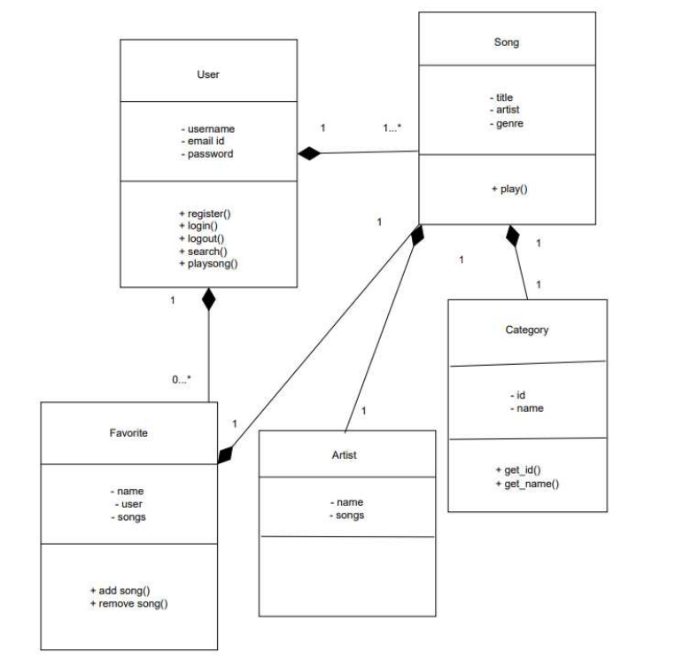
Class diagram

Slide 8
CHALLENGES FACED

